Slide 1
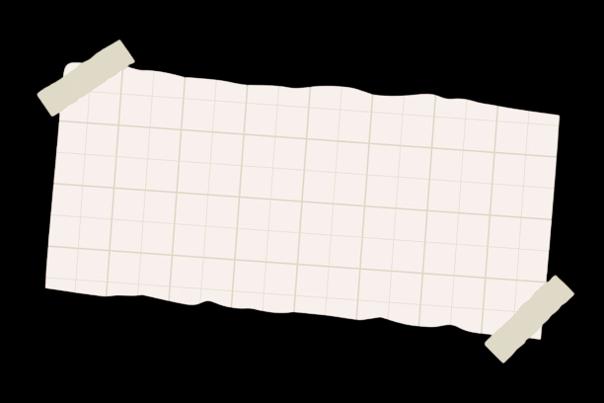

My Portfolio Website
Designed & Developed by K. Avantika

Slide 2
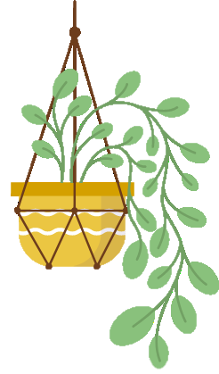
Digital Portfolio
STUDENT NAME: K.Avantika
REGISTOR NO AND NMID: 222411461 /
448A92D33B56DDD94D04ADC5365F9ECE
DEPARTMENT: BSC .COMPUTER SCIENCE
COLLEGE/UNIVERSITY: Mangalam College of Arts & Science/University of Madras

Slide 3
Project title
Interactive digital portfolio using front end development

Slide 4
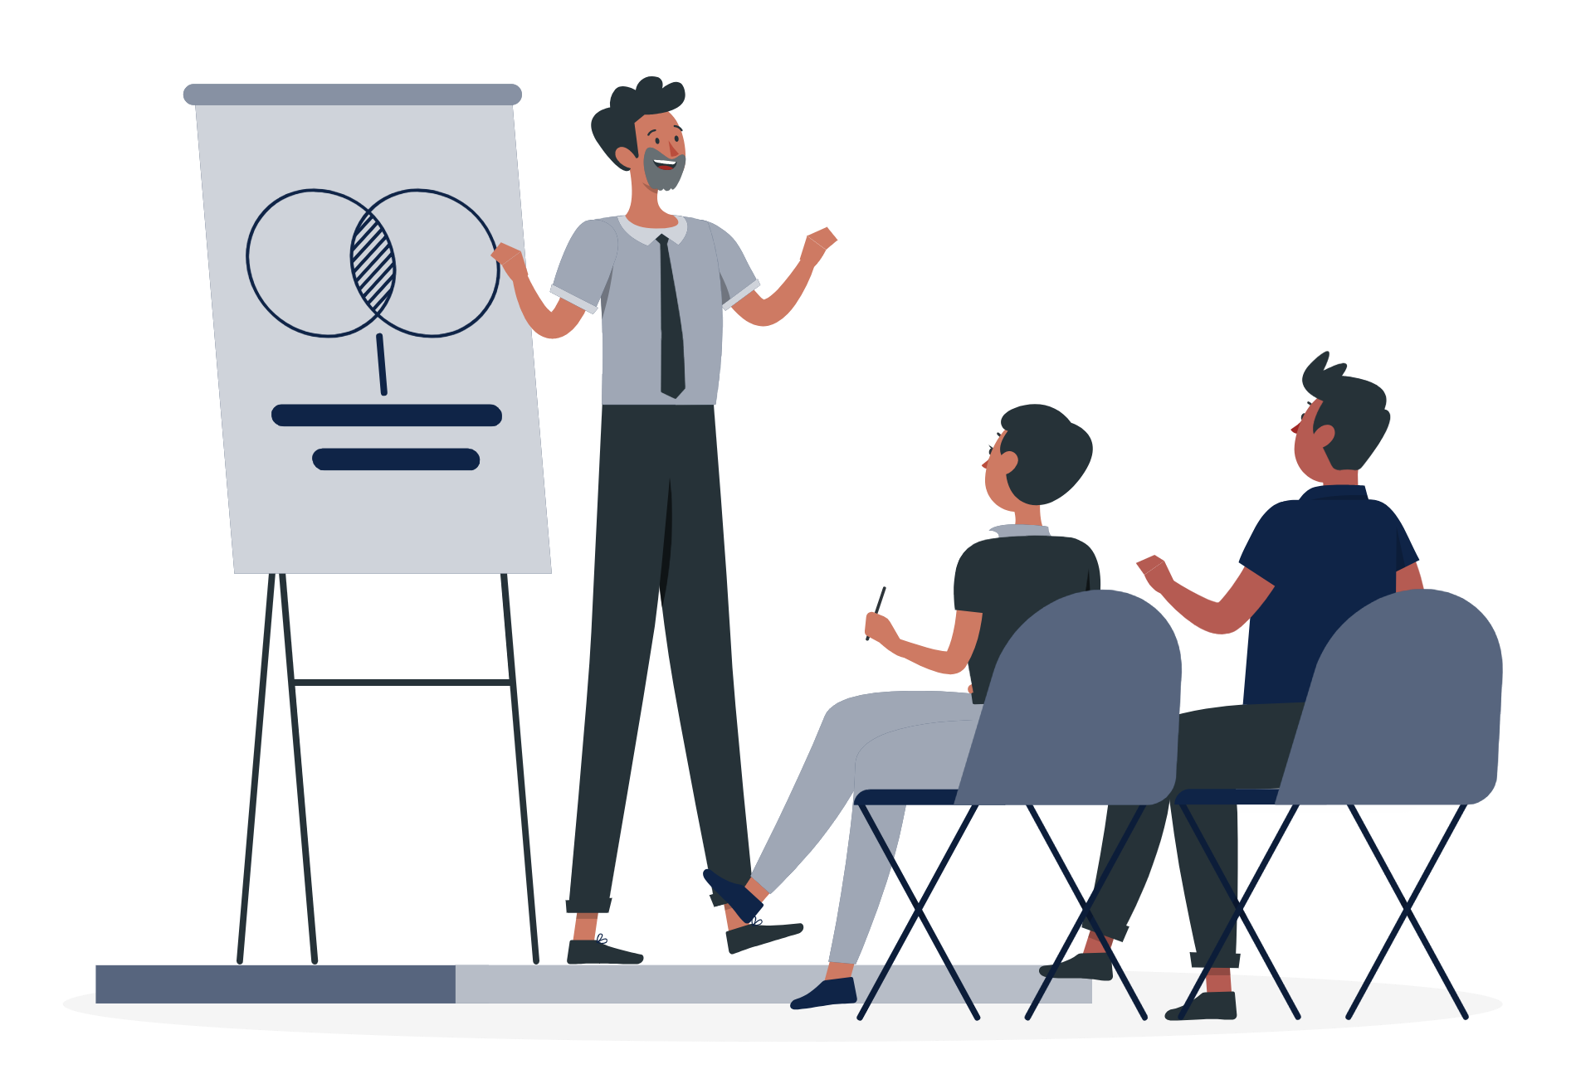
Agenda
1
Problem Statement
2
Project Overview
3
End Users
4
Tools and Technologies
5
Portfolio design and Layout
6
Features and Functionality
7
Results and Screenshots
8
Conclusion
9
Github Link

Slide 5



.
Problem Statement
Traditional resumes are not enough to showcase skills and projects.
Students and professionals often lack a structured online presence.
Recruiters/clients prefer quick, interactive, and visual portfolios.
Solution: A personal digital portfolio to present achievements, skills, and projects in a professional and engaging way

Slide 6
.
Project Overview
Goal: Build a modern, responsive personal portfolio website.
Sections:Home – Intro + call to action
About Me – Personal details & career goals
Education – Academic background
Skills – Technical expertise
Certificates – Achievements with images
Contact/Footer – Social links for networking
Purpose: Highlight achievements, skills, and projects in a visually appealing and professional format.

Slide 7
.
Who are the end users
Students: Showcase academic projects & achievements.
Job Seekers: Share as a digital resume with recruiters.
Freelancers: Present work samples to potential clients.
Professionals: Build a strong online presence.

Slide 8
Tools and Techniques
1
2
3
4
5
HTML: Semantic structure (header, section, footer).
CSS: Styling, layout, responsiveness, pastel theme.
JavaScript: Mobile menu toggle, smooth scrolling.
Icons: Font Awesome for visual cues. Typography: Google Fonts
Code Editor: VS Code.
Hosting: GitHub

Slide 9
Portfolio Layout and Design
Minimal, modern, and pastel-themed design.
Fully responsive: Works seamlessly on desktop & mobile.
Boxed card layout: Sections appear inside smooth rounded containers with subtle shadows
Hero section: Circular profile picture + intro + call-to-action button.

Slide 10
.
Features and Functionality
Navigation bar: Fixed top, smooth scrolling, responsive hamburger menu.
Projects & Certificates: Displayed in cards with hover effects.
Interactive UI: Color transitions, hover highlights.
Contact Section: Social media links for easy networking.
Responsive: Adapts beautifully to all screen sizes.

Slide 11
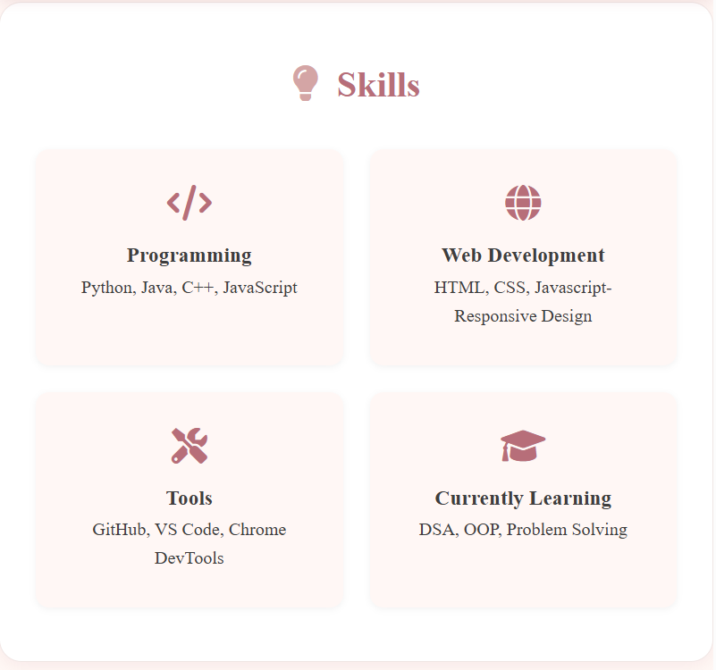
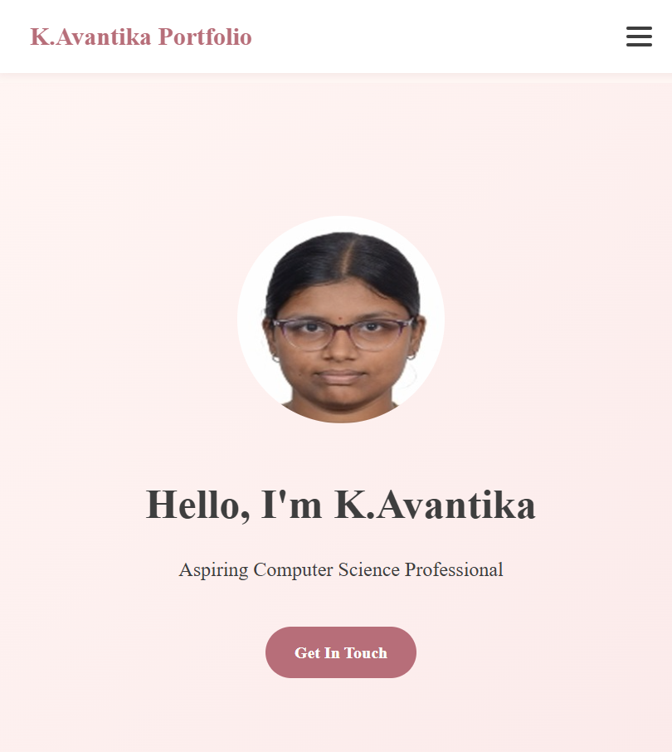

Results and Screenshots
Skills section grid layout
Mobile view

Slide 12
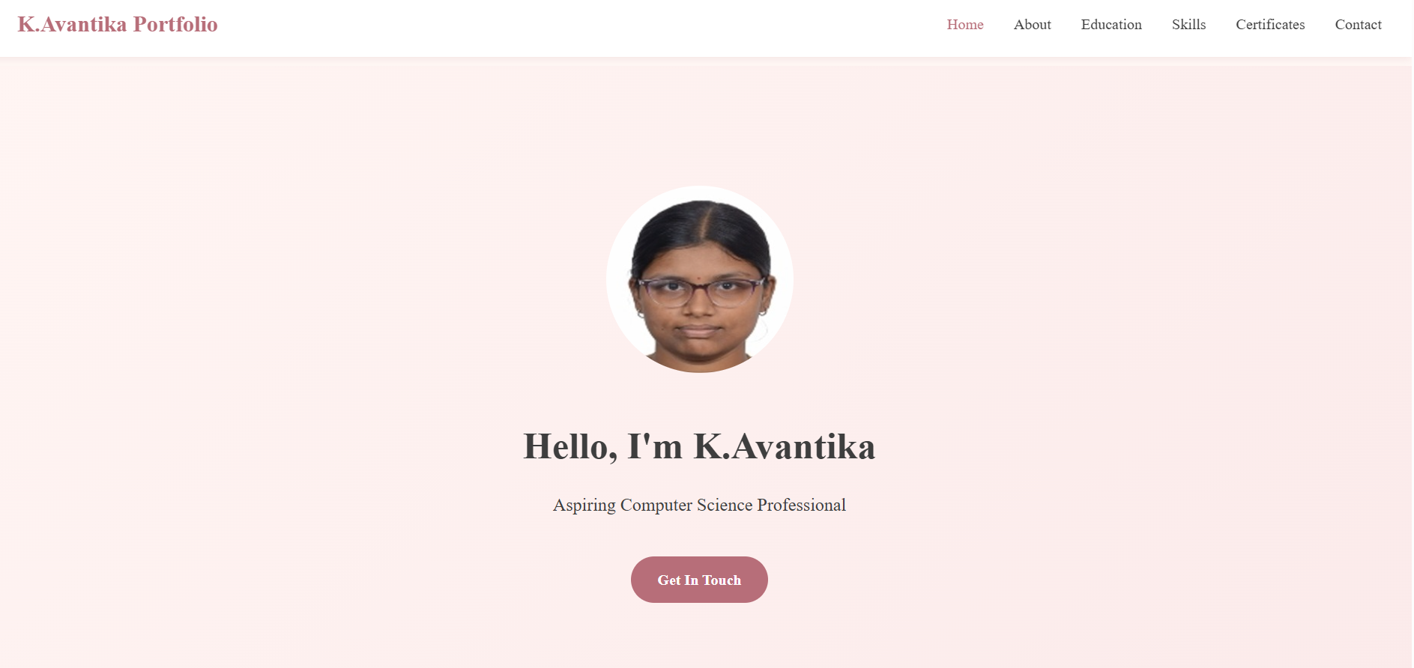
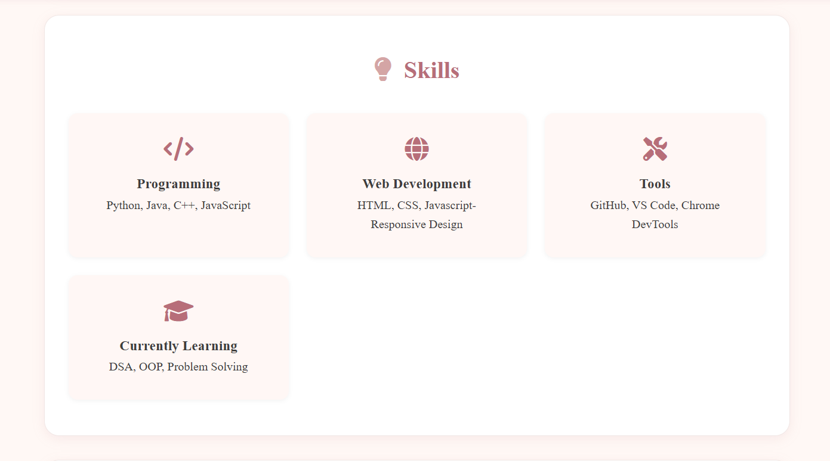
Results and Screenshots
Skills section grid layout
Desktop view

Slide 13
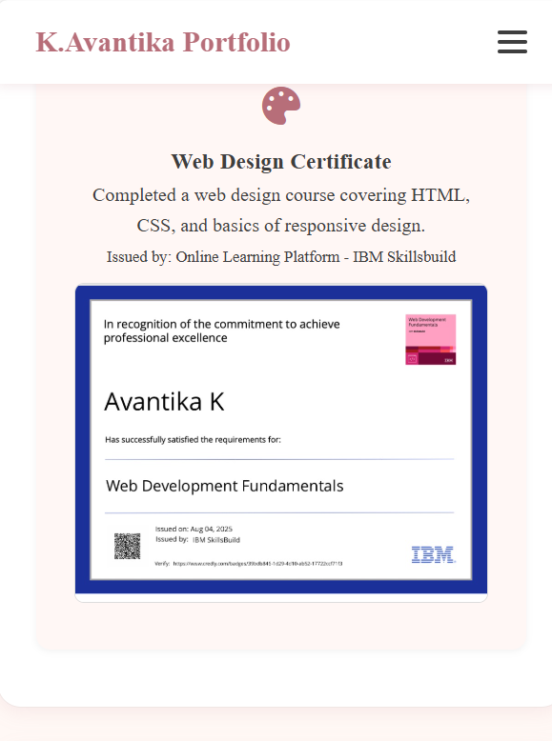
Results and Screenshots
Outcome:
Clean, professional, and visually engaging portfolio.
Easy navigation for recruiters, teachers, or peers.
Certificate section with actual certificate image

Slide 14
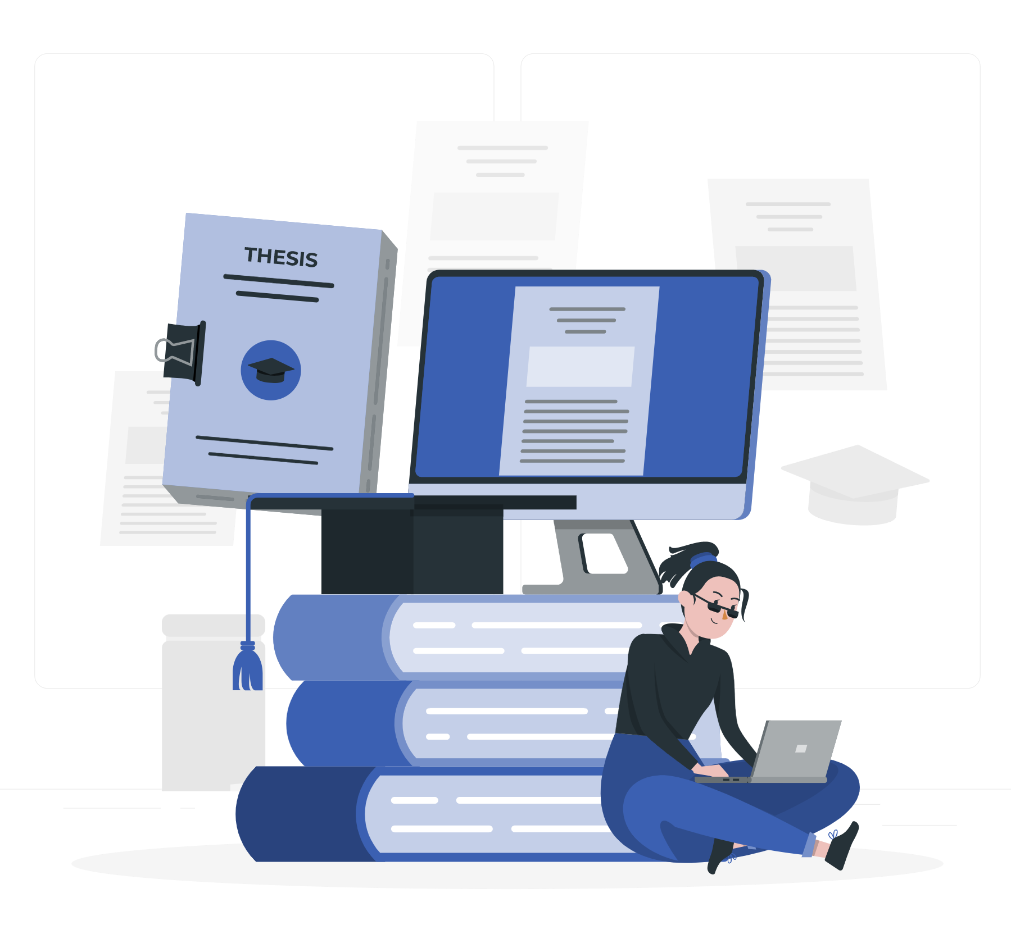
Conclusion
Highlights:
Built with clean code & modern design.
Showcases academic, technical, and personal achievements.
Responsive & user-friendly interface.
Benefits:
Helps me present myself professionally.
Can be shared with recruiters or professors as a digital CV.
Scalable – future-ready for projects, blogs, or more features.
Github link: https://github.com/K-Avantika Portfolio Link: https://k-avantika.github.io/Naan-Mudhalvan-Portfolio-Project/

Slide 15

Thank You

